Slide 1
M&HRSPL provides a wide range of services to individuals and businesses in a variety of industries. At M&HRSPL, we strive to meet each client's specific needs in planning for the future and achieving their goals in an ever-changing Organizational environment.
Our process has been proven since 2011 (Formerly known as Niratanka Management Services). For the last few years, we have grown in placing professionals across multiple industries with varied skills. We provide Payroll Services & all types of Recruitment Services that includes Contract Labour, Placement Services, Manpower Recruitment, HR Consultancy, and Staffing Solutions. We provide end-to-end solutions for start-ups, small and medium organizations.
www.mhrspl.com

Slide 2
PAYROLL SERVICES
We offer a comprehensive payroll outsourcing services and help you to reduce the time spent on the administration by handling all the compliance and administrative tasks of payroll management of your company. we have a team of experts in payroll compliance and labour laws and facilitate best service in your company's compliance and administrative tasks of payroll management .

Slide 3
EVERYTHING ABOUT YOUR PAYROLL SERVICES AT YOUR FINGERTIPS. BE IT PAYSLIP, TAX WORKINGS,SAVINGS DECLARATION ETC.
One time activity
Uploading all employee demographic details in the portal
Uploading salary structure to the portal
Collecting income tax deduction declaration from all the employees
Recurring
Collecting employee attendance details from the company, new employee add, any employee quit etc.
Liason with company contact for any changes in salary structure, bonus etc.
Sharing monthly payslips to employees through the portal
Sharing Income tax computation sheet through the portal
Remittance of statutory dues to govt. authorities like income tax (TDS), profession tax, provident fund, ESI
Filing monthly/quarterly/annual statutory returns for all statutory obligations
Issuing of annual form 16 (Salary certificate) to employees
Crediting salary to employee bank account

Slide 4
INCLUSIVE CONTROLS
Manage multiple payroll controls; be it head count, compensation changes, deduction, payment, or compliance reassurances.

Slide 5
AVAILABLE ON MOBILE
Everything you need to know about your Payroll readily available on your mobile device. Whether it be Payslip, Tax workings, or etc.

Slide 6
Core HR Management
Core HR - Where Everything Begins
Capture all employee data
Easy tools to carry out various employee lifecycle activities, such as addition, confirmation, resignation, etc. and maintain complete work history.
Manage lifecycle activities
Easy tools to carry out various employee lifecycle activities, such as addition, confirmation, resignation, etc. and maintain complete work history.
Search employee data
Use powerful search and querying capabilities to quickly locate, consume, or update employee information.
Track employee assets
Monitor your company’s asset-related information, especially upon an employee’s resignation, promotion or transfer. At all times, know which company assets are being used by which employee.
Collect and update KYE information
Manage Know Your Employee (KYE) information by:
Storing various employee identity information
Tracking verified status (Aadhaar verified, PAN verified, etc.)
Using the Data Drive feature to collect identity data online

Slide 7
Employee Self Onboarding: A Pleasant Onboarding Experience
Paperless Onboarding Process
Switch to a streamlined online process instead of dealing with piles of paperwork. Employees can now self onboard themselves with minimum HR intervention.
Integrated Document Management
Integrated document upload facility for educational certificates, ID proofs, etc. Uploaded documents automatically show up in Employee Documents on approval.
Review Workflow
Workflow for reviewing, validating and approving data entered by employees. Only verified and approved data is updated to the main employee records database.
Ensure New Hire Compliance
Measure your onboarding efforts through reports and have an accurate audit trail of information by new hire and HR.

Slide 8
Employee Communication, Reminders and Alerts
Manage employee communication
Quickly send out a memo or a bulk email to selected or all employees. You can publish or send a mass email to targeted employee(s). Also, maintain complete communication history.
Send reminders and alerts
Access and use 30+ pre-built employee lifecycle events. Publish automated greeting cards; customize and send reminders and alerts to:
New joinees
Employees who are resigning
Employees on their birthdays, anniversaries and confirmations
Use notification templates
Configure and use notification templates (email, SMS, etc.) to send notifications by email, social feeds, SMS and mobile push notifications.
Update and publish company policies and forms
As your organization grows, your need to keep all employees updated about various company-related information, policies and forms increases. Within a few clicks, greytHR’s core HR management software module helps you to:
Publish/ update company policies and employee handbook
Publish/ update commonly required forms and templates

Slide 9
HR Reports and Dashboards
Use readymade HR MIS reports
Core HR software module provides you with reports for insightful and meaningful HR analytics. Other than statutory and Labour Law reports, you can also access readymade HR MIS reports and also create your own user-defined and ad-hoc reports easily.
Gain insights from HR dashboards
Design your own dashboard by simply dragging and dropping the chart type and various parameters. Use the HR dashboard to quickly get an overview of employees joining or leaving the organization, confirmations due, etc.
Gain insights from CEO dashboards
Track performance indicators automatically from the CEO dashboard. Gain insights such as employee costs, statutory costs, attrition, average years in service, etc.

Slide 10
Employee Document Management
Manage and access employees’ documents
Store digital or scanned copies of employees' documents, access all issued letters and documents, upload documents in bulk, scan all uploaded documents for security and file all generated letters automatically.
Generate letters to employees
Generate all kinds of official letters (address proof, salary certificate, experience, confirmation, offer, increment, transfer, etc.) with just one click. Access and use a large letter gallery with pre-built templates and formats.

Slide 11
Payroll Management
Complete payroll processing
Process payroll with a single click
After you’ve configured and implemented greytHR as per your needs, a click is all that you need to process employee salaries.
Use guided payroll processing with checklist
If new to the process, tool, or you want to review and verify data while processing payroll, don’t worry; Select the manual payroll process option to process payroll in a guided manner with the help of an online checklist.
Compute accurate salaries automatically
On clicking Process Payroll, greytHR accurately and automatically computes salary for all employees including statutory deductions (PF/PT/ESI/TDS), loan deductions, arrears, revisions, loss of pay, pro-rata salary, IT computation, etc.
Use extensive reconciliation tools
Verify accuracy in each payroll by using a variety of payroll reconciliation tools at your disposal. Compare current and previous month’s payroll and also, customize salary register and payroll statements as per your needs.

Slide 12
Configurable salary structure
Configure complex salary structures
In-built payroll calculator offers flexibility to handle any type of salary structure. Define highly customizable salary structure specific to your industry standards, specifications, or requirements and employee category.
Add unlimited salary components
Add unlimited salary components from our repository to create a salary structure that suits your business needs or industry/ statutory norms/ regulations. Some of these salary components are standard while some are highly specific components.

Slide 13
Automated payroll inputs and payslips
A growing organization needs to accommodate not just basic payroll but also reimbursements, loans and advances for employee betterment.:
Extensive reimbursement configurations
Monthly/ annual entitlements
Claims processing with limit checking
Providing loans with multiple repayment and interest options
Pausing loan deductions for a specified period
Automatic closure on completion of repayment
Automatic calculation of perquisites

Slide 14
Comprehensive Post-Payroll Process
Generate statutory reports
Generate statutory return file formats, such as PF ECR file, ESI Returns, PT reports of all states and Form 24Q returns without any additional data entry work.
Disburse salaries with ease
greytHR’s payroll management software allows you to disburse salaries through any bank through multiple payment modes, such as cheque and bank transfers. Also, it has:
All major bank transfer electronic formats built in
Batch-wise/ bank-wise payment release
Status tracker for cash and cheque payments
Generate Accounts JV
Payroll doesn’t end with payslip distribution, reconciliation or disbursement. To have a smooth link between your finance and payroll teams, our payroll system allows you to generate Accounts JV easily via:
In-built formats for Tally
Highly configurable JV (split by cost center/ employees)
Extensive Excel output capabilities

Slide 15
100% statutory compliance
Enjoy complete compliance
All statutory deductions for PF, ESI, Professional tax, IT, etc., are automatically updated by our payroll system as per the latest laws and amendments. The payroll management system provides you these features along with all required and customized reports:
PF calculations with ECR generation
ESI computations and challans
PT with all state-specific rules built in
Comprehensive TDS (IT) calculations and eTDS returns
One-click Form 24Q generation with automatic FVU validation
Digitally signed Form 16 and 12BA generation
Bonus calculations and reporting
Labour Welfare Fund calculation and deductions

Slide 16
Generate payroll reports
Readymade and standard reports, including statutory reports.
Our payroll management system provides you with multiple configuration parameters for the following reports:
Reconciliation reports
PT reports
MIS reports
Ad-hoc and user-defined reports
Customizable payroll statement/ salary register/ wage register
Reports under Shops & Establishment Acts of various states
Reports under CLRA Act of various states

Slide 17
Leave Management
Fully customizable leave policies
Create multiple leave types
Create any number of leave types and define leave policies for each type exclusively: earned leave, sick leave, casual leave, maternity leave, marriage leave, bereavement leave, etc.
Customize configure leave policies
Allows you to configure various types of leave policies like leave granting, leave availing restrictions, week end policies, leave pro rating, leave year end processing etc.
Access library of standard policies
Choose a policy from our library of standard leave policies, in case you don’t have a leave policy in place.

Slide 18
Holiday lists
Holiday lists
Create your own holiday list. You can also import your own holiday list from Excel.
Create regional or location-based lists
You can create different holiday lists for different locations, if your organization is geographically distributed across states or countries.
Add Restricted Holidays
You can also select and add Restricted Holidays (optional holidays) and set rules for these holidays according to your leave policy.
Publish company’s holiday list
Easily prepare and publish the company's holiday list, including both general and restricted holidays.

Slide 19
Minimal leave-related tasks and queries
Grant leaves automatically
Grant leaves for eligible employees automatically on a monthly, quarterly, half-yearly or annual basis. greytHR brings you a powerful online leave management system that encompasses all leave-related concerns and queries. All leave transactions of an employee are tracked and leave balances, automatically updated.
Let employees and managers handle leave requests
Our Employee Self Service (ESS) portal completely shifts the responsibility of applying for leave, its approval and rejection and comp-off granting to employees and their managers, respectively.
Focus more on strategic HR tasks
Our ESS enables you to focus on more important strategic HR tasks while it takes care of:
Online leave application, tracking and approval between employees and their managers with near-zero HR intervention
Automatic tracking and updating of leave balances of all employees
Access leave reports
Access and view built-in standard and statutory leave reports, such as Leave Availed Report, Negative Leave Balance Report, Leave Encashment Report, etc., from the Leave Reports Gallery.

Slide 20
Leave year-end processing
Leave year-end processing need not mean extra work anymore.
Automate leave lapsing, carry-forward and encashment, etc. With our easy-to-use leave year end process, complete the year-end processing to automatically compute leave lapses, carry-forwards, leave encashments, etc., for all employees as per your policy. Get accurate results and a smooth transition to the next leave year.
Choose a year end process as per convenience. Choose from manual or automatic methods of leave year-end processing as per your convenience.

Slide 21
EMPLOYEE SELF SERVICE Portal
ESS portal - General Activities
View your own information
View your personal information, such as payslips, personal details, etc.
View your official documents and letters
Access, download and print any official documents and letters published onto the ESS by the HR or Payroll personnel for you.
View company policies and forms
Access, download and print the latest company policies, forms and employee handbook published onto the ESS by the HR or Payroll personnel.
Leverage the power of social networking
Just like any social network, view, like and comment on real-time company updates, events and news on our Social Feeds section. Appreciate colleagues, debate and discuss various topics with them and so on.
Search for and view employees
Search for and view any employee-related information via the employee directory. The directory shows employee information, such as his/ her designation, reporting manager, email ID, photograph, extension, etc.

Slide 22
ESS portal - Payroll
View payroll information
View payslips, total earnings statements, Reimbursement statements and Reimbursement claims, and PF and YTD statements. Also, view details related to loans or advances like installments paid, balance payable, etc.
View and update tax-related information
View, upload and update income tax plans. Compare multiple income tax plans and submit the best tax-saving plan for payroll consideration. Upload and submit final IT Proof Of Investments.
Payroll inputs
Submit payroll inputs such as FBP, reimbursement claims, IT declaration and POI.

Slide 23
ESS portal - Leave
View leave balances and holidays
View leave balances (across all leave types) and holiday details.
Manage leave transactions
Employees and managers can apply for and approve or reject leaves/ restricted holidays, respectively, based on leave balances and project requirements.
View team’s leave information
Managers can view their team members’ leave-related information before approving or rejecting leave requests. They can also view the leave balance summary in a dashboard format.

Slide 24
ESS portal - Help Desk
Use as IT Help Desk
Raise tickets for hardware or software requirements, internet or intranet access and access to other IT assets/ networks. These then reach the IT team for resolution.
Use as Admin Help Desk
Raise tickets for facility management issues, such as cleanliness, air-conditioning, cafeteria or water dispensers.
Use for Recruitment needs
Managers or department heads can easily and directly raise requests to the recruitment team to help fill open positions within the department.
Use as Accounts Help Desk
Address queries and concerns related to TDS, loans or even the final settlement amount.
Use as HR Help Desk
Raise HR queries, concerns and requirements via the Help Desk without mailing or meeting them in person.

Slide 25
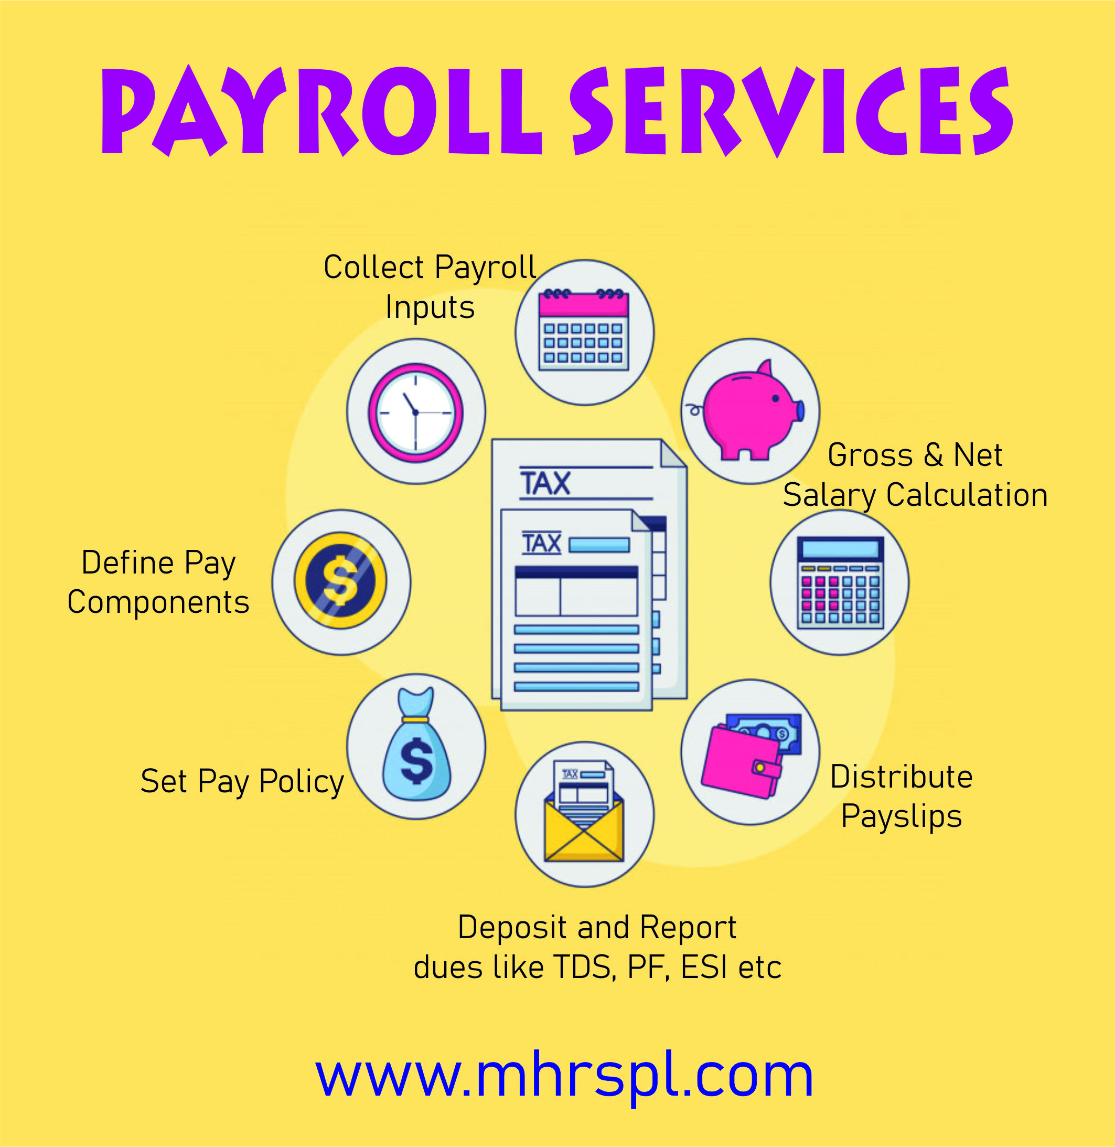
Thank You
M&HR Solutions Private Limited
No. 326, 2nd Floor, Opp. Syndicate Bank, Near Dr. AIT College, Kengunte, Mallathahalli, Bangalore - 560 056, Email: hrniratanka@mhrspl.com, Phone : 080-23213710, Mob: 9980066890

